Slide 1
Structured Programming Language
Nahidul Islam
Lecturer, Dept. of CSE
DCC, Dhaka.
1/31/2023
1

Slide 2
ARRAY

Slide 3
What is array ?
Many applications require the processing of multiple data items that have common characteristics (e.g., a set of numerical data, represented by x1, x2, . . . ,xn). In such situations it is often convenient to place the data items into an array, where they will all share the same name (e.g., x). The individual data items can be characters, integers, floating-point numbers, etc. However, they must all be of the same type.
Each array element (i.e., each individual data item) is referred to by specifying the array name followed by one or more subscripts, with each subscript enclosed in square brackets. Each subscript must be expressed as a nonnegative integer. In an n-element array, the array elements are x[0], x[1], x[2] . . . ,x [n – 1]

Slide 4
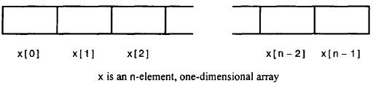
What is array ?
Defining an array
type array_name [array_size];
This is called a single-dimensional array. The array_size must be an integer constant greater than zero and type can be any valid C data type.
int x[100]; char text [80] ;

Slide 5
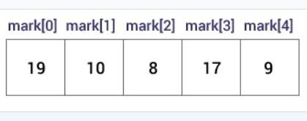
What is array ?
int mark[5] = {19, 10, 8, 17, 9};

Slide 6
What is array ?
several array definitions that include the assignment of initial values :
int digits[10] = {1, 2, 3, 4, 5 , 6, 7, 8, 9, 10};
char color[3] = { 'R' , 'E', 'D' } ;
digits[0] = 1
digits[1] = 2
digits[2] = 3
digits[3] = 4
digits[4] = 5
digits[5] = 6
digits[6] = 7
digits[7] = 8
digits[8] = 9
digits[9] = 10
color[0] = 'R'
color[1] = 'E'
color[2] = ' D '

Slide 7
What is array ?
char color[3] = "RED”;
The number of values between braces { } can not be larger than the number of elements that we declare for the array between square brackets [ ].

Slide 8

What is array ?
int digits[5] = {3, 3, 3};
digits[0] = 3
digits[1] = 3
digits[2] = 3
digits[3] = 0
digits[4] = 0
If you omit the size of the array, an array just big enough to hold the initialization is created. Therefore, if you write:
double balance[ ] = {1000.0, 2.0, 3.4, 17.0, 50.0}; You will create exactly the same array

Slide 9
#include<stdio.h>
int main()
{
int i=0;
int marks[5]={20,30,40,50,60};//declaration and initialization of array
//traversal of array
for(i=0;i<5;i++){
printf("%d \n",marks[i]);
9. }
10. return 0;
11.}

Slide 10
// Program to take 5 values from the user and store them in an array
// Print the elements stored in the array #include <stdio.h>
int main()
{
int values[5];
printf("Enter 5 integers: ");
// taking input and storing it in an array for(int i = 0; i < 5; ++i)
{
scanf("%d", &values[i]);
}
Array Input/Output
printf("Displaying integers: ");
// printing elements of an array for(int i = 0; i < 5; ++i)
{
printf("%d\n", values[i]);
}
return 0;
}
10

Slide 11
Example
Calculate Average Using Arrays
This program takes n number of element from user(where, n is specified by user), stores data in an array and calculates the average of those numbers.

Slide 12
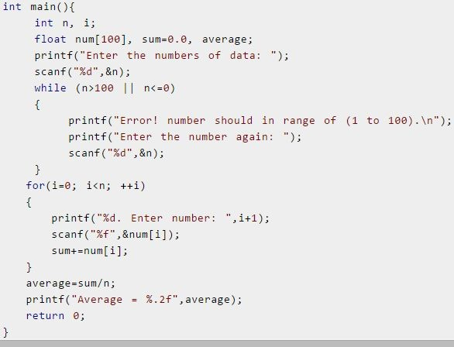

Slide 13
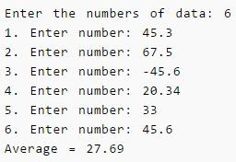
Output:

Slide 14
Display Largest Element of an array
This program takes n number of element from user(where, n is specified by user) and stores data in an array. Then, this program displays the largest element of that array using loops.

Slide 15
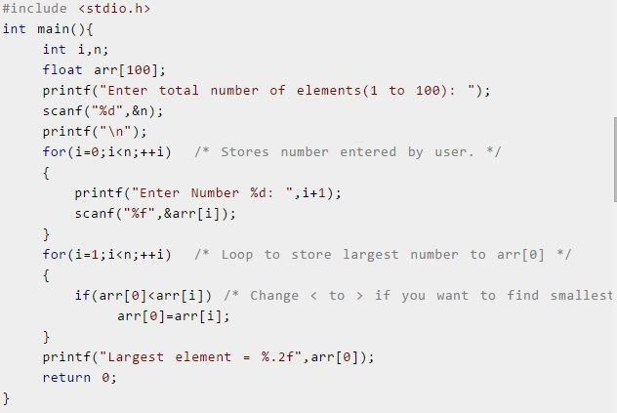

Slide 16
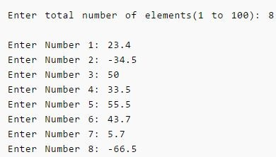
Output:
Largest element= 55.5

Slide 17
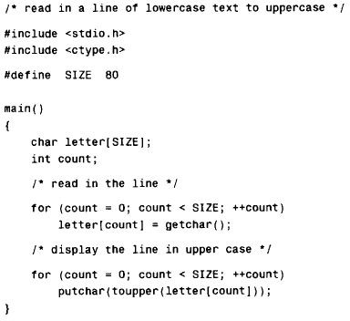

Slide 18
PASSING ARRAYS TO FUNCTIONS
An entire array can be passed to a function as an argument. The manner in which the array is passed differs markedly, however, from that of an ordinary variable.
To pass an array to a function, the array name must appear by itself, without brackets or subscripts, as an actual argument within the function call. The corresponding formal argument is written in the same manner, though it must be declared as an array within the formal argument declarations.
When declaring a one dimensional array as a formal argument, the array name is written with a pair of empty square brackets. The size of the array is not specified within the formal argument declaration.
Some care is required when writing function prototypes that include array arguments. An empty pair of square brackets must follow the name of each array argument, thus indicating that the argument is an array. If argument names are not included in a function declaration, then an empty pair of square brackets must follow the array argument data type.

Slide 19
PASSING ARRAYS TO FUNCTIONS
#include <stdio.h>
void getarray(int arr[]) 3.{
printf("Elements of array are : ");
for(int i=0;i<5;i++)
{
printf("%d ", arr[i]);
8. }
9.}
10.int main() 11.{
int arr[5]={45,67,34,78,90};
getarray(arr);
return 0;
15.}
In this program, we have first created the array arr[] and then we pass this array to the function getarray(). The getarray() function prints all the elements of the array arr[].

Slide 20
Example
Write a C program that passes a three-element integer array to a function, where the array elements are altered. The values of the array elements are displayed at three different places in the program, thus illustrating the effects of the alterations.

Slide 21
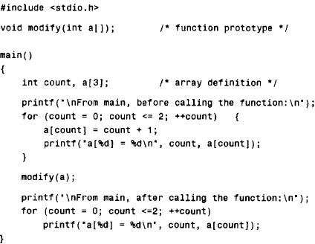
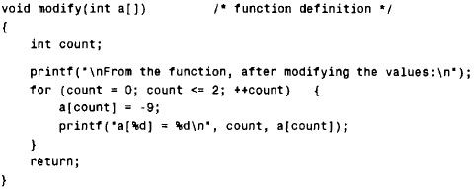

Slide 22
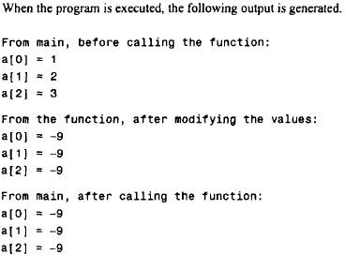
PASSING ARRAYS TO FUNCTIONS

Slide 23
PASSING ARRAYS TO FUNCTIONS
// how to pass an array to a function as a pointer
#include <stdio.h>
void printarray(char *arr) 3.{
printf("Elements of array are : ");
for(int i=0;i<5;i++)
{
printf("%c ", arr[i]);
8. }
9.}
10.int main() 11.{
char arr[5]={'A','B','C','D','E'};
printarray(arr);
return 0;
15.}
23

Slide 24
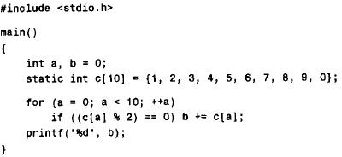
Find output

Slide 25
Find output
Output of previous program:
20 (sum of the array elements whose values are even)

Slide 26
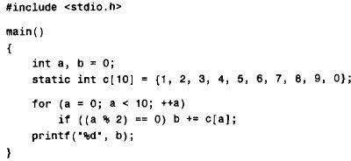
Find output

Slide 27
Find output
Output of previous program:
25 (sum of the even array elements)

Slide 28
Thank you
28

